Slide 1

Introduction into fMRI analysis. PsyMsc4 (Goethe 2021).
Session-2
Javier Ortiz-Tudela and Francesco Pupillo
1
Notes:
1

Slide 2
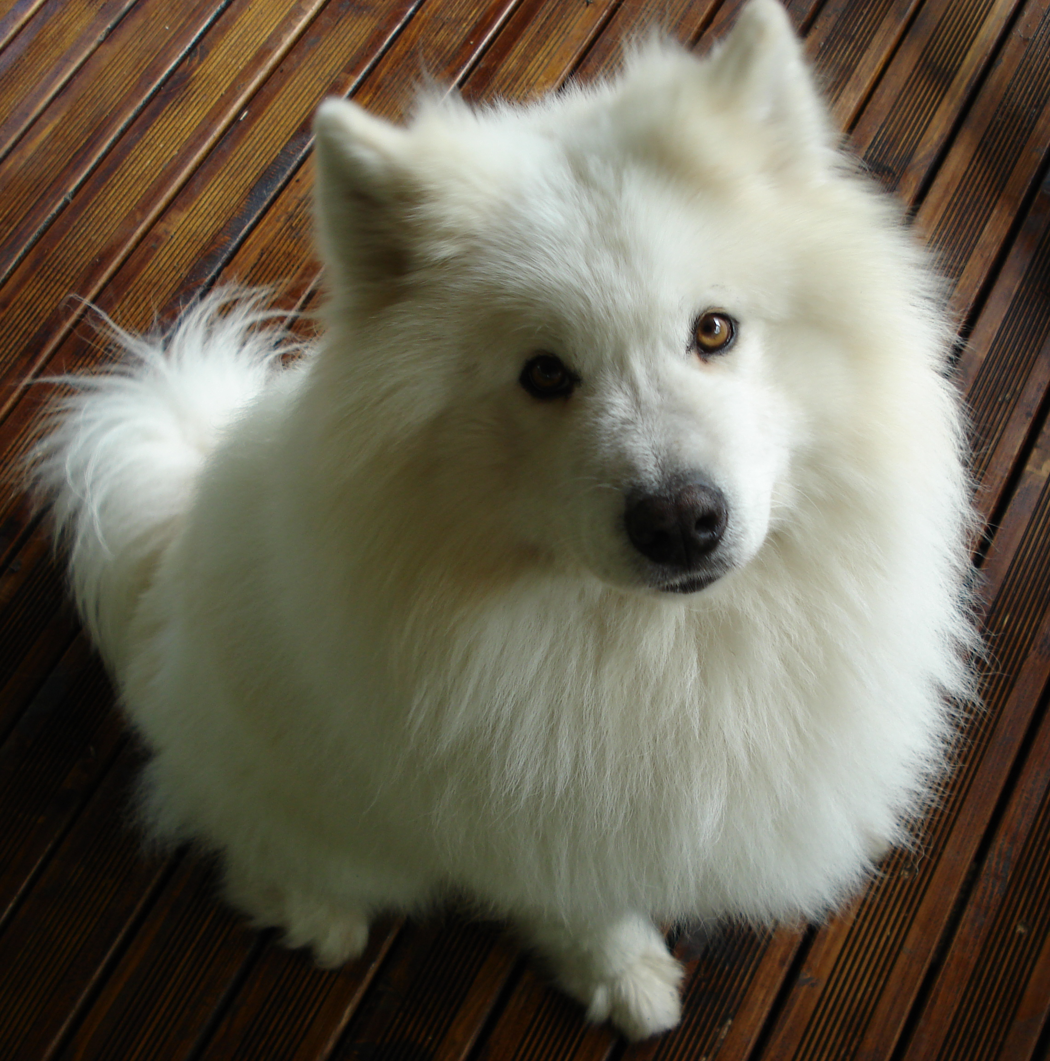

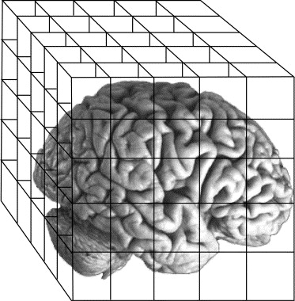
Recap of last week
MR basics:
- Scanner = magnet + RF transmitter
- MRI relies on the magnetic properties of the tissue.
- MR images are 3D “pictures” composed of voxels with one value per voxel.
- Most common 3D files: NifTi (.nii) and compressed NifTi (nii.gz).
- Spatial resolution depends on scanner strength.
QUESTIONS?
Type of images:
MR images can be roughly grouped into anatomical and functional images.
Anatomical images (usually one volume) have higher spatial resolution than functional images (usually several volumes).
TR = time to collect one brain volume.
Runs = acquisition windows.
Preprocessing:
- Slice-time correction
- Magnetic field distortions
- Intensity inhomogeneities
- Motion correction
- Registration
- Normalization
2
Notes:
2

Slide 3
Recap of last week
MR images are a collection of voxels (3D matrix) with a value (a number) in each cell.
The value represents a different thing for anatomical and functional images.
3
Notes:
3

Slide 4
Functional MRI. BOLD signal.
Functional images are used to study brain activity.
But what does brain activity look like when looked through a MR scanner?
4
Notes:
4

Slide 5
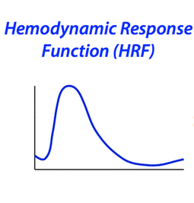
Functional MRI. BOLD signal.
Functional images are used to study brain activity.
What we are recording in our functional sequences is actually blood oxygen level dependent​ (BOLD) signal.
But what does brain activity (BOLD) look like when looked through a MR scanner?
5
Notes:
5

Slide 6
Functional MRI. BOLD signal.
Rise
Undershoot
Initial dip
0s
~15s
Recovery
6
Notes:
6

Slide 7
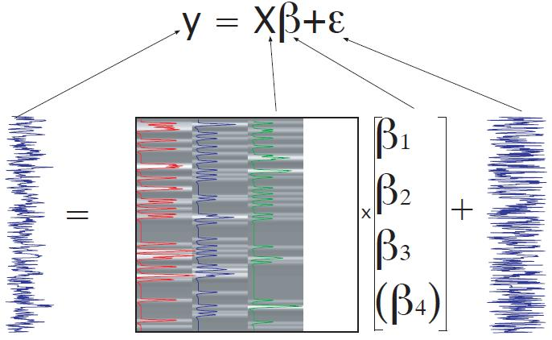
Functional MRI. BOLD signal.
This is the ‘ideal’ response to stimulation but, of course, the measured signal is noisier.
Measured signal in 1 voxel over many volumes
Time
7
Notes:
7

Slide 8
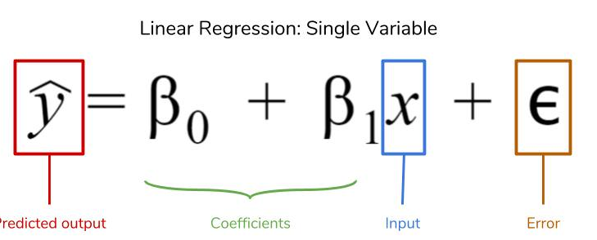
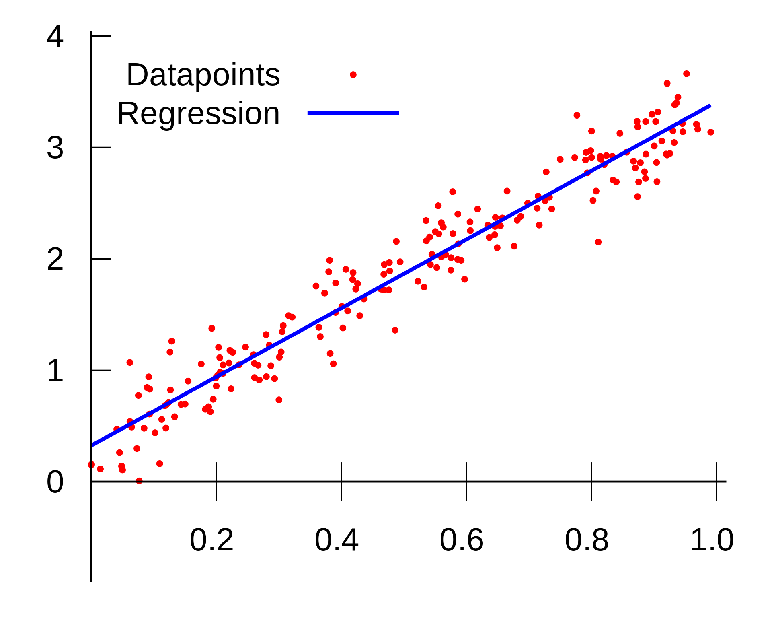
GLM. Generalized Linear Models
If you remember your stats class…
Intercept
Slope
from Wikipedia
8
Notes:
8

Slide 9
GLM. Generalized Linear Models
If you remember your stats class…
Intercept
Slope
QUESTION: What does the beta value represent?
from Wikipedia
9
Notes:
9

Slide 10
GLM. Generalized Linear Models
Regression is the usual approach for analysis of fMRI signals.
Measured signal in 1 voxel over many volumes
Time
10
Notes:
10

Slide 11

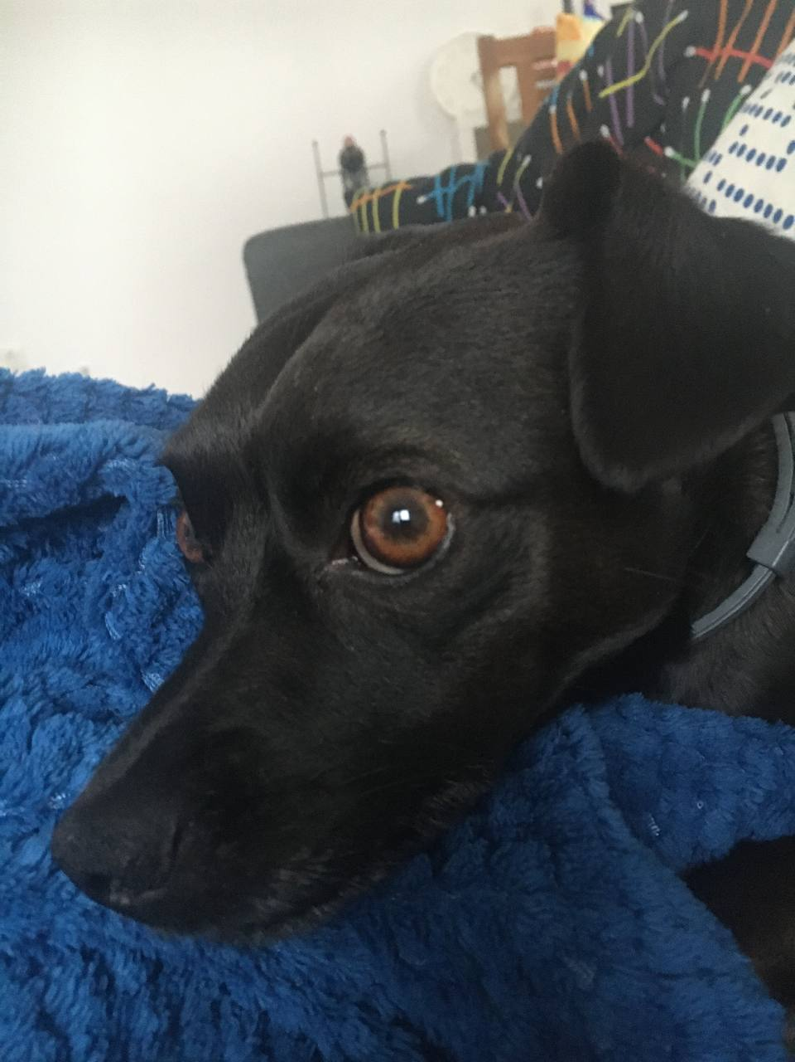
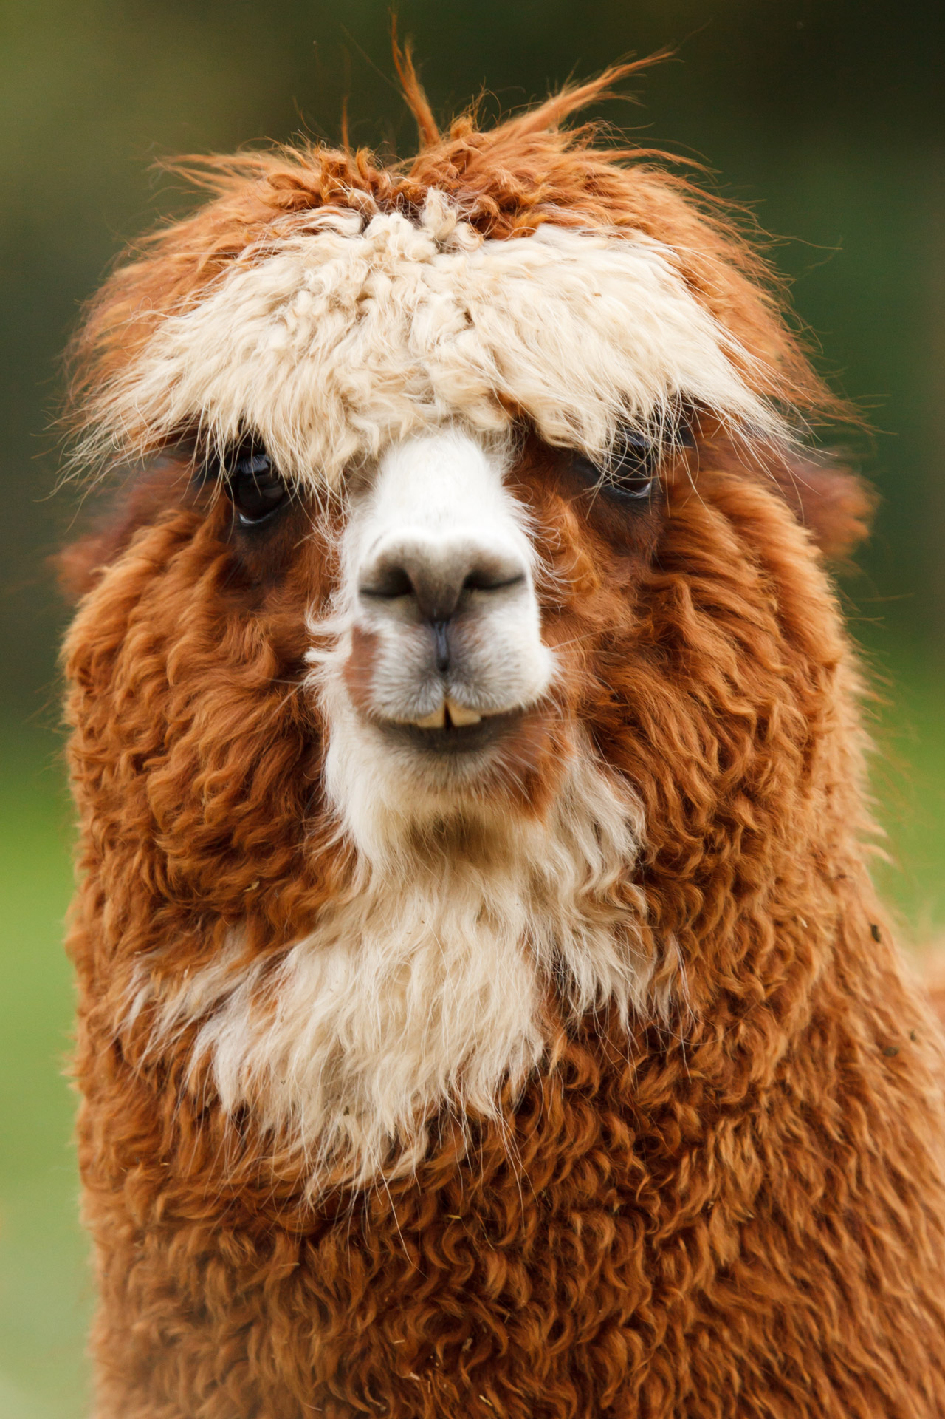
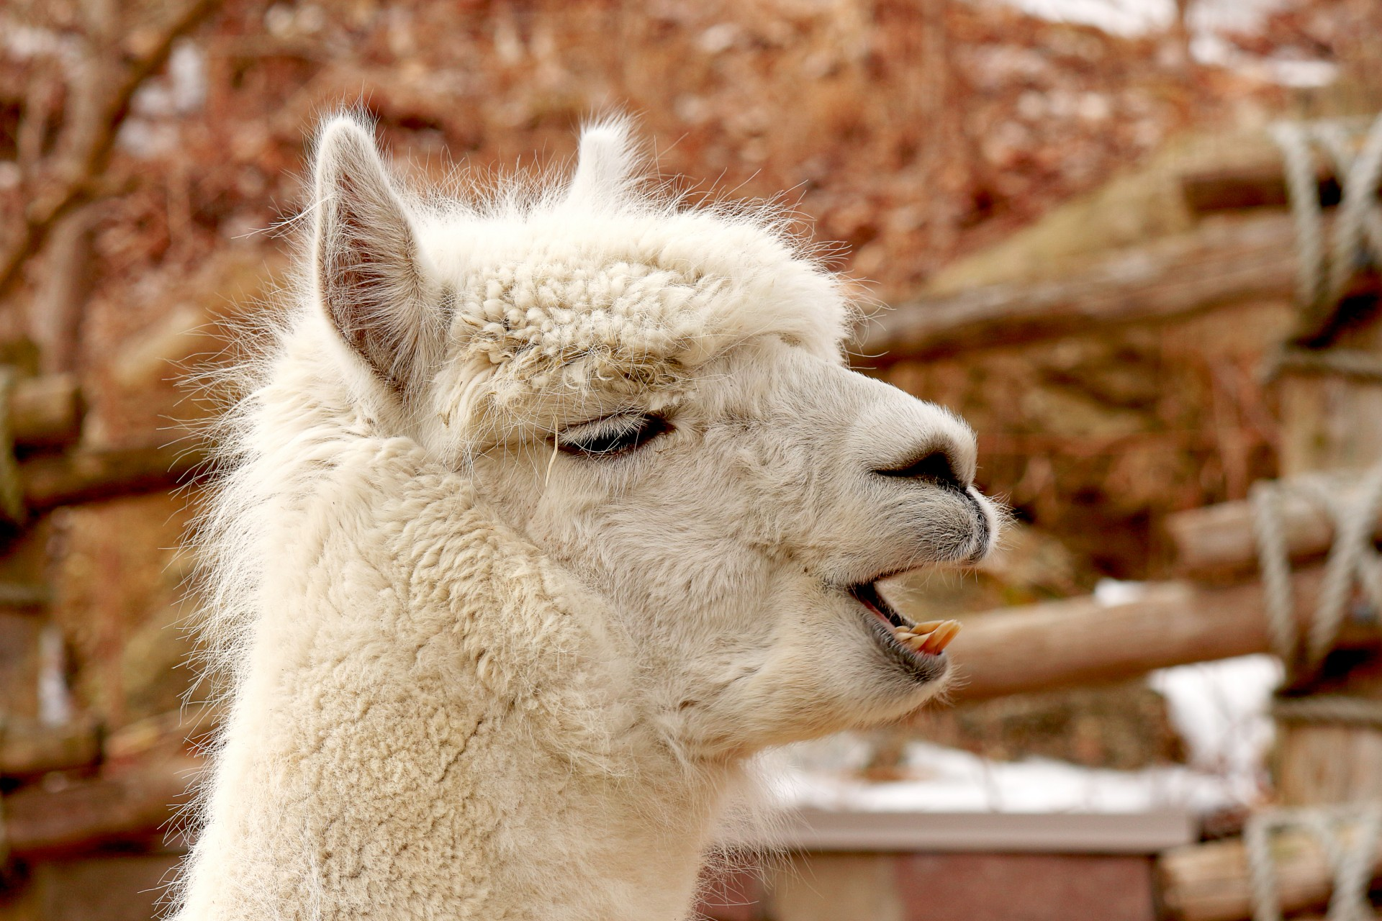
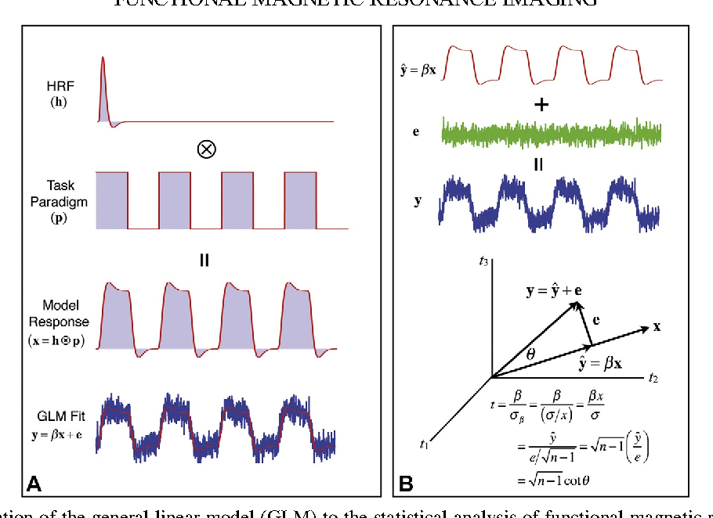
GLM
A practical example. Can we find voxels that respond to ANIMAL FACES?
Task
(visual stim.)
+
+
+
Voxel
activity
Time
Task
model
Present
Absent
Time
Notes:
11

Slide 12
GLM
A practical example. Can we find voxels that respond to ANIMAL FACES?
Task
(visual stim.)
+
+
+
Voxel
activity
Time
Task
model
Present
Absent
Time
Notes:
12

Slide 13
GLM
A practical example. Can we find voxels that respond to ANIMAL FACES?
Voxel
activity
Time
Task
model
Present
Absent
Time
Response
model
Notes:
13

Slide 14
GLM
A practical example. Can we find voxels that respond to ANIMAL FACES?
Voxel
activity
Time
Now we can use regression to obtain an estimate (beta) of how much our response model explains our BOLD signal in our voxel.
Task
model
Present
Absent
Time
Response
model
Notes:
14

Slide 15
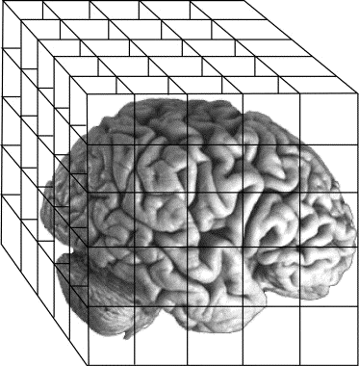
GLM
A practical example. Can we find voxels that respond to ANIMAL FACES?
If run for every voxel, we will get one beta estimate per voxel, i.e., a beta map
Voxel
activity
Time
Task
model
Present
Absent
Time
Response
model
Notes:
15

Slide 16
GLM
A practical example. Can we find voxels that respond to ANIMAL FACES?
QUESTION: What would the value in each voxel of the beta map represent?
Voxel
activity
Time
Task
model
Present
Absent
Time
Response
model
Notes:
16

Slide 17
GLM
A practical example. Can we find voxels that distinguish to DOGS FACES from ALPACAS FACES?
Voxel
activity
Time
Task
model
Present
Regressor 1
Absent
Regressor 2
Time
Notes:
17

Slide 18
GLM
A practical example. Can we find voxels that distinguish to DOGS FACES from ALPACAS FACES?
If run for every voxel, we will get one beta estimate per voxel, i.e., a beta map
Voxel
activity
Time
Task
model
Present
Absent
Time
Notes:
18

Slide 19
GLM
A practical example. Can we find voxels that distinguish to DOGS FACES from ALPACAS FACES?
QUESTION: What would the value in each voxel of the beta map represent?
Voxel
activity
Time
Task
model
Present
Absent
Time
Notes:
19

Slide 20
GLM
Another practical example. Can we find voxels that distinguish each CHARACTER?
Voxel
activity
We can have a regressor and, therefore, a beta for every trial.
Time
Task
model
Present
Beta1
Absent
Beta2
Beta3
Beta4
Notes:
20

Slide 21
GLM
Different GLM (task) models. LSU is widely used for univariate analysis while LSA (or more complex models) are often used for multivariate analysis.
Least-Squares Unitary (LSU)
Least-Squares All (LSA)
Beta1
Beta1
Beta2
Beta2
“One beta per condition is estimated”
Beta3
Beta4
“One beta per trials is estimated”
There are also more complex models: Least-Squares Separate (LSS), LS-1, LS-2...
Notes:
21

Slide 22
GLM
Interim recap.
- fMRI sequences measure BOLD signal.
Regression is the usual approach to analyze BOLD signal change.
We use the condition (or stimulus) time course to model BOLD time course in each voxel.
Regression will give us beta estimates for each voxel.
The number (and meaning) of each beta estimates depends on the task model that we use.
Beta1
Beta2
Notes:
22

Slide 23
GLM
Back to theory.
We have seen that (task) regressors can be used to check if the time course of our variables correlates with signal change in the brain.
But the BOLD signal can also change with stuff other than our variables.
We do not want our results to be driven by (confounded with) other stuff.
Beta1
Beta2
stuff
Intercept
Slope
Notes:
23

Slide 24
GLM
Back to theory.
We have seen that (task) regressors can be used to check if the time course of our variables correlates with signal change in the brain.
But the BOLD signal can also change with stuff other than our variables.
Enter: Nuisance/confound regressors.
Beta1
Beta2
stuff
Intercept
Slope
Notes:
24

Slide 25
GLM
Nuisance regressors.
What can affect signal change in a given voxel?
Head motion.
Breathing.
Heart rate.
Scanner drift.
…
Notes:
25

Slide 26
GLM
Nuisance regressors.
If we can identify the time course of each factor that we believe can influence our signal change, we can add them in our model.
fMRIPrep carpet plot
Notes:
26

Slide 27
GLM
Nuisance regressors.
Betas estimated from nuisance regressors are usually not of interest for our analysis but they can account for an important portion of the variance in our signal.
It is important to know how many nuisance regressors we will include in our model because that will change the number of betas we get out of the regression!
Error to be minimized
Intercept
Slope
Notes:
27

Slide 28
GLM
QUESTION: Should we convolve our nuisance regressors with an HRF?
Nuisance regressors.
fMRIPrep carpet plot
Error to be minimized
Intercept
Slope
Notes:
28

Slide 29
GLM
General recap.
- fMRI sequences measure BOLD signal.
Regression is the usual approach to analyze BOLD signal change.
We use the condition (or stimulus) time course to model BOLD time course in each voxel.
Regression will give us beta estimates for each voxel.
The number (and meaning) of each beta estimates depends on the task model that we use.
Nuisance regressors can help “cleaning” our signal.
Beta1
Beta2
Notes:
29

